Slide 1


Performance Analysis According to The Number of Hidden Layers in MNIST Data Set
201952004 Kim Taeyeoun (김태연)
Dept. of Information and Communication Engineering,
DGIST, Korea
2019 / 04 / 22

Slide 2
CONTENTS
Artificial Neural Network model design
Accuracy analysis
Learning time analysis
conclusion
Project Presentation 2019-04-22

Slide 3
Artificial Neural Network model Design
Fully-Connected model
784 Input nodes
784 Input nodes
500 Hidden nodes
200 Hidden nodes
200 Hidden nodes
10 Output nodes
10 Output nodes
. . .
. . .
. . .
. . .
. . .
. . .
. . .
784 Input nodes
784 Input nodes
500 Hidden nodes
200 Hidden nodes
500 Hidden nodes
200 Hidden nodes
100 Hidden nodes
100 Hidden nodes
10 Output nodes
10 Output nodes
. . .
. . .
. . .
. . .
. . .
. . .
. . .
. . .
. . .
. . .
. . .
300 Hidden nodes
Project Presentation 2019-04-22

Slide 4
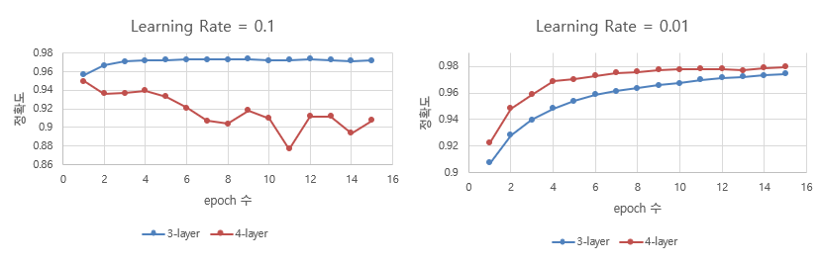
Accuracy analysis
3-layer & 4-layer
Project Presentation 2019-04-22

Slide 5
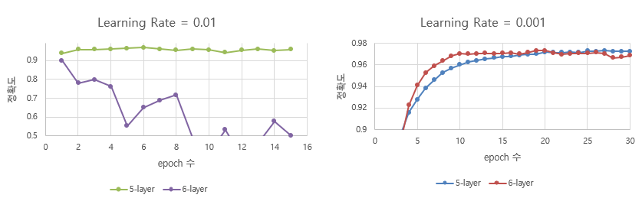
Accuracy analysis
5-layer & 6-layer
Project Presentation 2019-04-22

Slide 6
Accuracy analysis
15 epochs | 3-Layer | 4-Layer | 5-Layer | 6-Layer
Lr = 0.1 | 97.19% | 90.77% | - | -
Lr = 0.01 | 97.43% | 97.97% | 95.82% | 50.17%
Lr = 0.001 | - | - | 96.77% | 97.07%
30 epochs | 3-Layer | 4-Layer | 5-Layer | 6-Layer
Lr = 0.1 | 96.81% | - | - | -
Lr = 0.01 | 97.81% | 98.09% | - | -
Lr = 0.001 | - | - | 97.26% | 96.88%
Project Presentation 2019-04-22

Slide 7
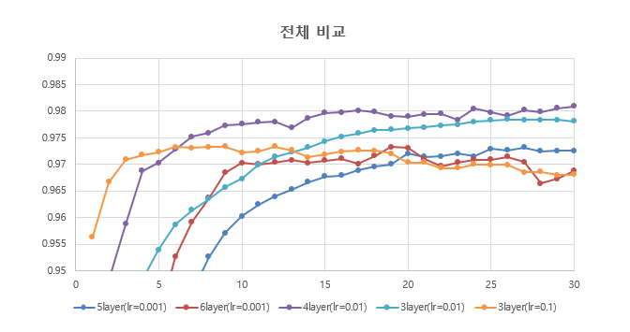
Accuracy analysis
Max accuracy | 3-Layer | 4-Layer | 5-Layer | 6-Layer
Lr = 0.1 | 97.34% | 94.99% | - | -
Lr = 0.01 | 97.85% | 98.09% | 96.74% | 89.8%
Lr = 0.001 | - | - | 97.32% | 97.33%
Project Presentation 2019-04-22

Slide 8
Learning time analysis
Intel(R) Core(TM) i7-7700 CPU @ 3.60GHZ
3-Layer : 784 – 200 – 10
-> 784X200, 200X10 = 158,800 nodes
4-Layer : 784 – 500 – 200 – 10
-> 784X500, 500X200, 200X10 = 494,000 nodes
5-Layer : 784 – 500 – 200 – 100 – 10
-> 784X500, 500X200, 200X100, 100X10 = 513,000 nodes
6-Layer : 784 – 500 – 300 – 200 – 100 – 10
-> 784X500, 500X300, 300X200, 200X100, 100X 10 = 623,000 nodes
 | 3-Layer | 4-Layer | 5-Layer | 6-Layer
Lr = 0.1 | 80.4 sec/epoch | 259.0 sec/epoch | - | -
Lr = 0.01 | 76.6 sec/epoch | 233.3 sec/epoch | 265.6 sec/epoch | 318.0 sec/epoch
Lr = 0.001 | - | - | 240.5 sec/epoch | 304.0 sec/epoch
Project Presentation 2019-04-22

Slide 9
Conclusion
Max accuracy | 3-Layer | 4-Layer | 5-Layer | 6-Layer
Lr = 0.1 | 97.34% | 94.99% | - | -
Lr = 0.01 | 97.85% | 98.05% | 96.74% | 89.8%
Lr = 0.001 | - | - | 97.32% | 97.33%
 | 3-Layer | 4-Layer | 5-Layer | 6-Layer
Lr = 0.1 | 12min 3.6sec | 4min 19sec | - | -
Lr = 0.01 | 33min 11.6sec | 1h 56min 39sec | 26min 33.6sec | 5min 18sec
Lr = 0.001 | - | - | 1h 48min 13.5sec | 1h 36min 16sec
Project Presentation 2019-04-22

Slide 10
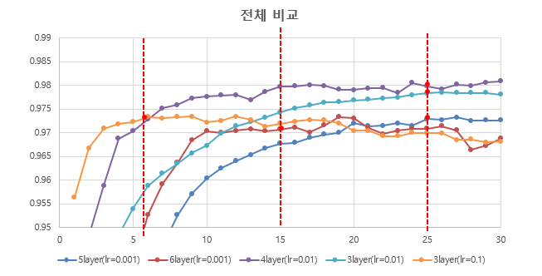
Conclusion
 | 3-Layer | 4-Layer | 5-Layer | 6-Layer
Lr = 0.1 | 97.33% 8min 2.4sec | - | - | -
Lr = 0.01 | 97.83% 31min 55sec | 97.98% 1h 37min 12.5sec | - | -
Lr = 0.001 | - | - | 97.29% 1h 40min 12.5sec | 97.07% 1h 16min
Project Presentation 2019-04-22

Slide 11
Python codes and learning results in
https://github.com/KimTaeyeoun/-Study/tree/master/%EC%A7%80%EB%8A%A5%20%EC%8B%9C%EC%8A%A4%ED%85%9C%20%EC%84%A4%EA%B3%84%20%EC%A4%91%EA%B0%84%EB%8C%80%EC%B2%B4%20%ED%94%84%EB%A1%9C%EC%A0%9D%ED%8A%B8
Project Presentation 2019-04-22

